Slide 1
Sentiment Analysis
on Yelp
IST664
IST 664 | Group 8 Liuqi Qian | Huiyu Li | Wenqing Ling | Dawei Guo

Slide 2
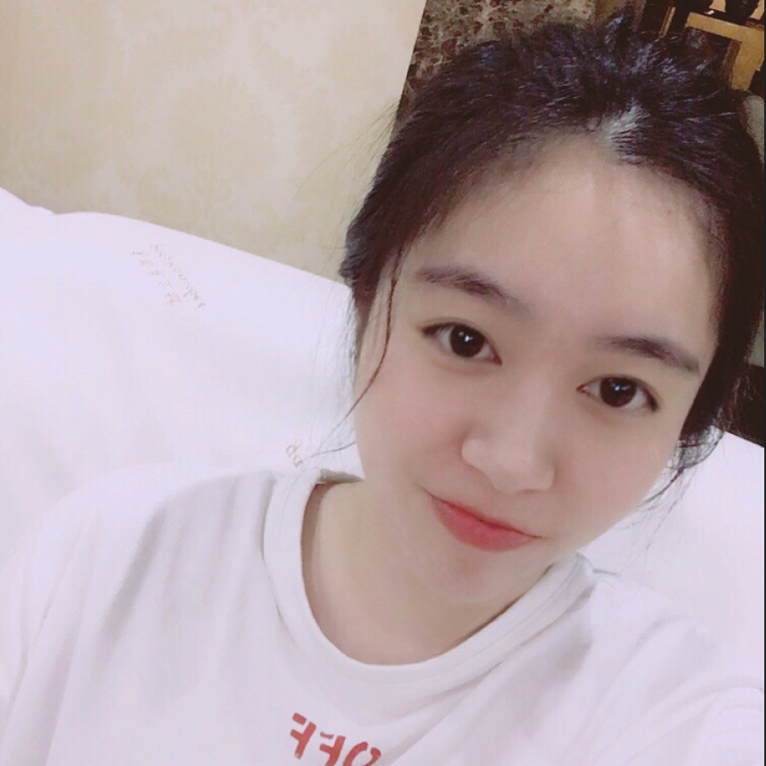


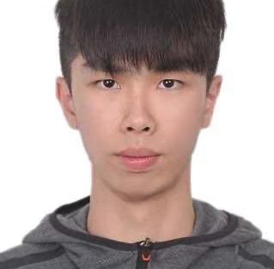
Group 8 Members:
Liuqi Qian
Huiyu Li
Dawei Guo
Wenqing Ling

Slide 3
Agenda:
Research Problem Statement
Source of Data Used
Data Cleaning and Prep Needed
Data Transformations
Model Built and Tested
Conclusion and Recommendation
Notes:
Qian

Slide 4

Yelp has over 135 million business and restaurant reviews worldwide.
Yelp is the city and travel guide to finding the perfect places to eat, shop, drink, relax, visit and play.
Yelp Features:
• Local eats
• Check restaurants information
• Dine at local restaurants
• Read restaurant reviews from other Yelp users
• Get amazing food deals for dining
Notes:
Qian

Slide 5
Research Problem
Statement
1
Notes:
datui

Slide 6

Main research Goal: analyzing the reviews on Yelp of 50 restaurants of Syracuse to get the overall customer attitudes toward each restaurant.
Scraping data from Yelp by using its API
Compound averages sorted in increasing orders.
Word Cloud
Build Random Forest Model (Train and Test)
The Veracity of the Model

Slide 7
Sourced of Data Used
2

Slide 8
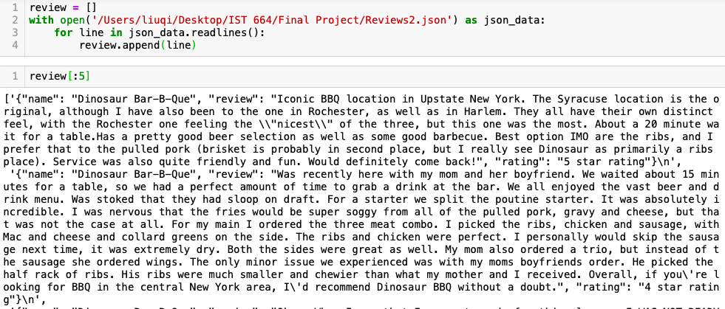
Yelp API
Original API offers 50 restaurants in Syracuse
Data Scraping and extract the reviews from restaurants website by using xpath and regular expression.
Notes:
datui

Slide 9
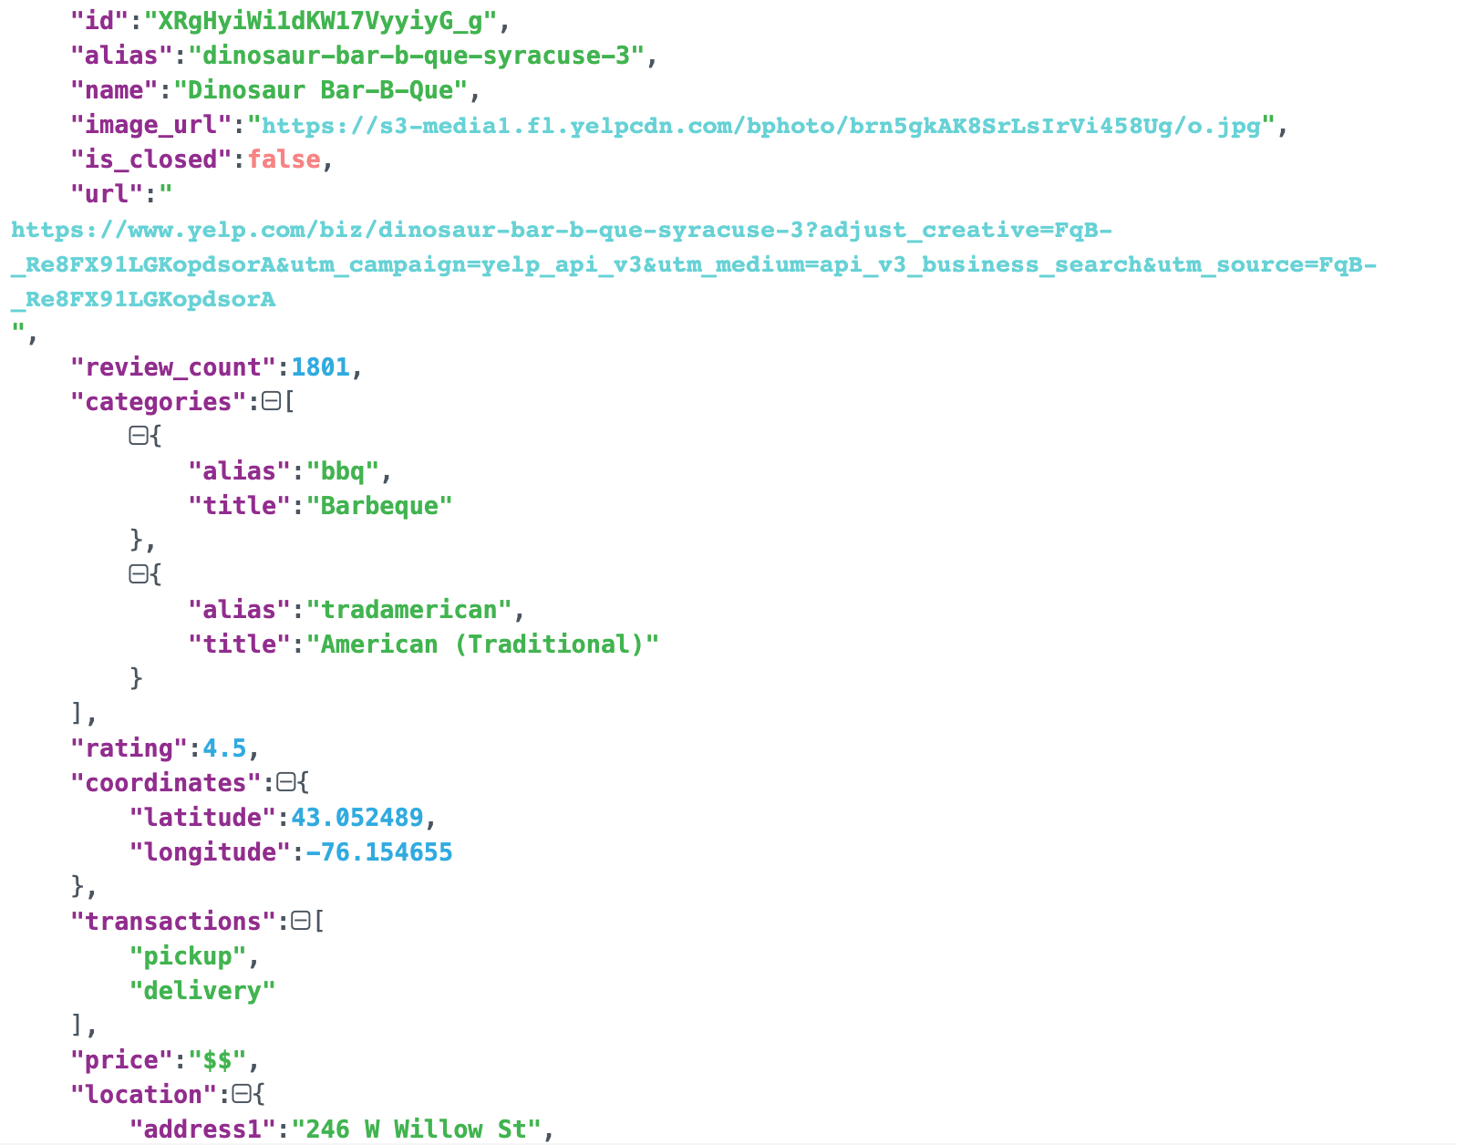
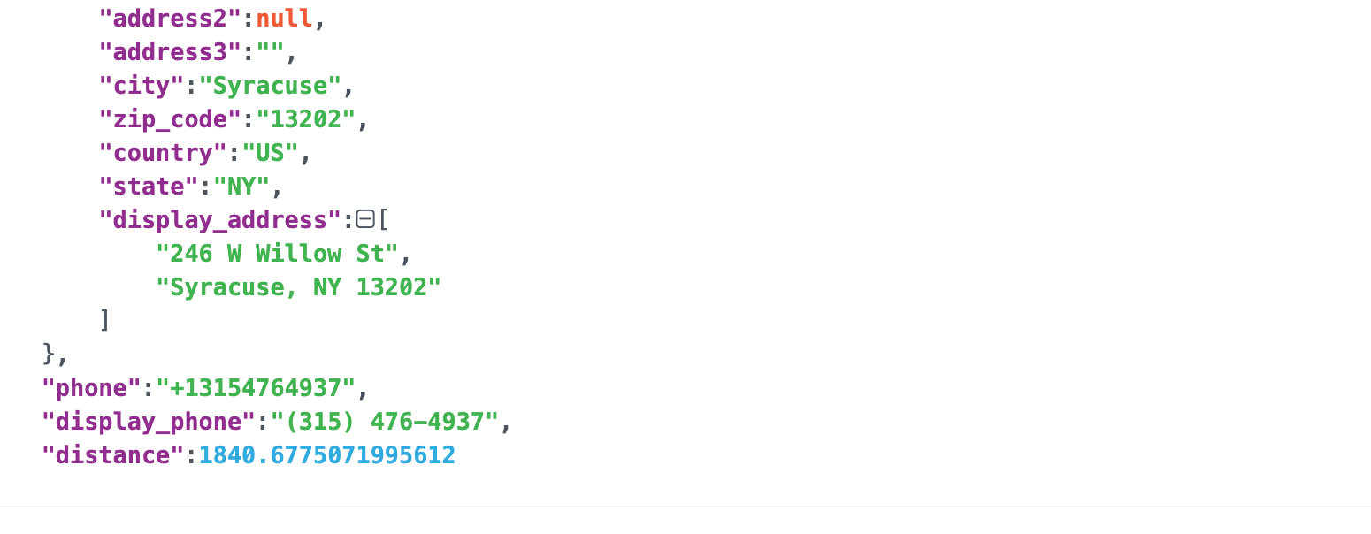
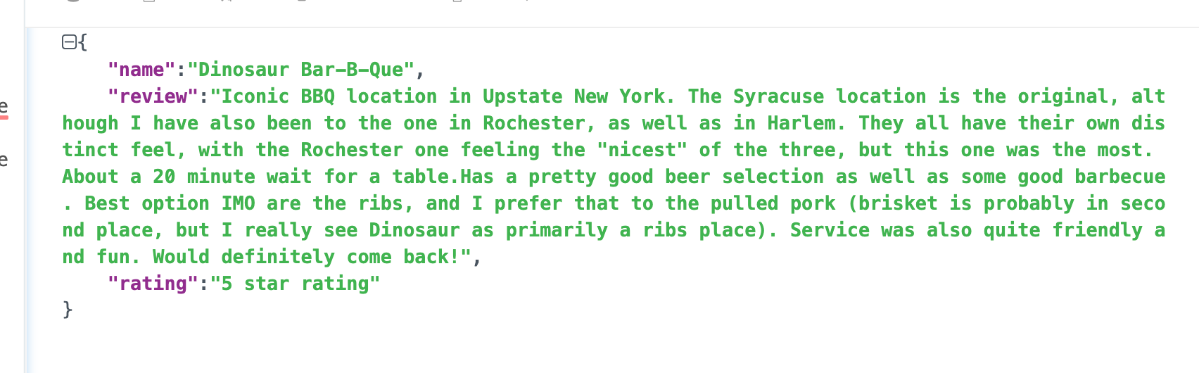
Restaurant.json | Reviews.json
Notes:
datui

Slide 10
Data Cleaning and Prep Needed
3

Slide 11
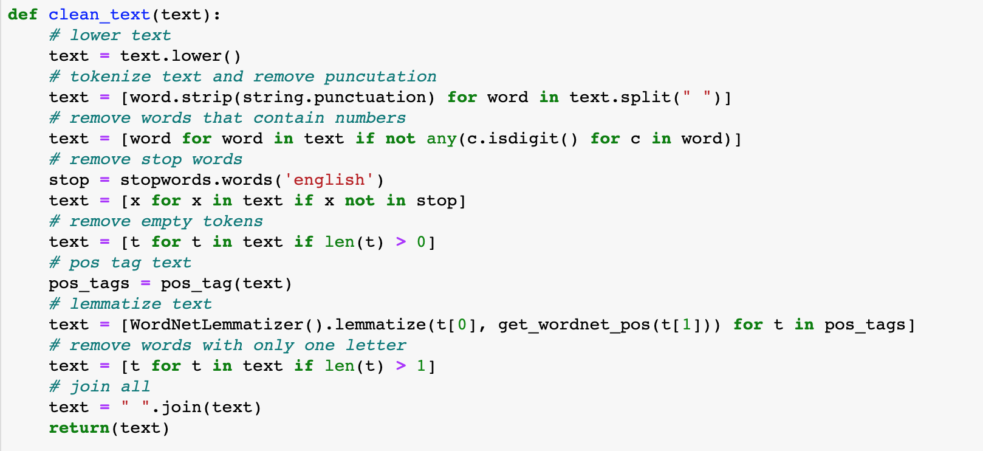
Data Cleaning
Cleaning methods:
lower text
tokenize text
remove punctuation
remove words that contain numbers
remove stop words
remove empty tokens
pos tag text
lemmatize text
remove words with only one letter
"I'm not new to this location or the brand! I've been here 4x times and I've been to at least 3 Dino locations. Each location has their own unique ambiance - service and food is always 5 star!Who would have thought some of the best BBQ is in upstate NY."
"i'm new location brand i've time i've least dino location location unique ambiance service food always star!who would think best bbq upstate ny"
Notes:
Qian

Slide 12
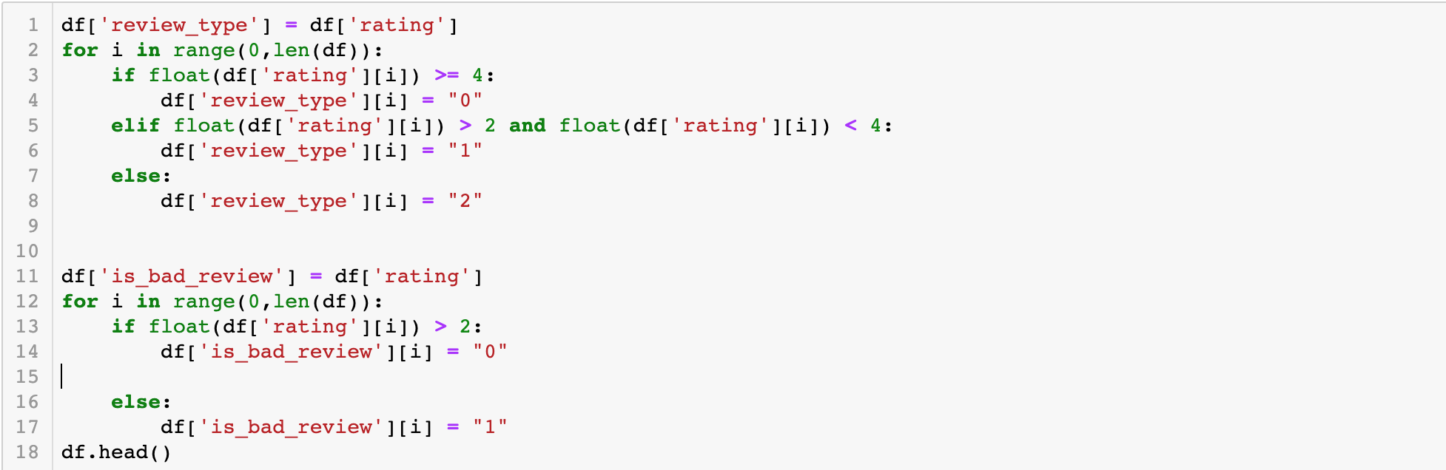
Prep Needed
We tagged the reviews by the rating from 1 to 5 stars.
The reviews with rating under 2 be tagged as Bad Reviews.
The reviews with rating between 2 and 4 be tagged as Neutral Reviews.
The reviews with rating greater than 4 be tagged as Good Reviews.
Notes:
Qian

Slide 13
Data Transformation
4

Slide 14
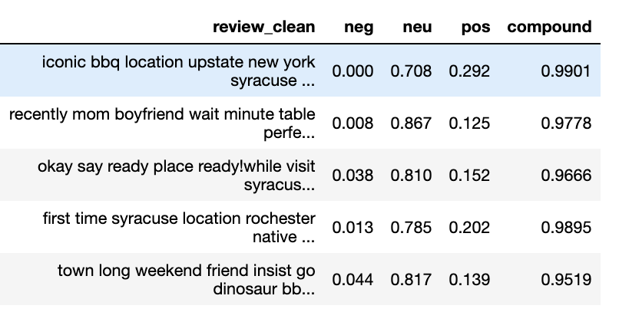
Add Sentiment Scores
We use Vader, which is a part of the NLTK module designed for sentiment analysis. Vader uses a lexicon of words to find which ones are positives or negatives.
neu: a neutrality score
pos: a positivity score
neg: a negativity score
compound: an overall score that summarizes the previous scores

Slide 15
Add Other Transformations
Next, we add some other transformations for every review:
number of characters in the review
number of words in the review
we created 5 vector for each review
Add the TF-IDF

Slide 16
Model Built and Tested
5

Slide 17
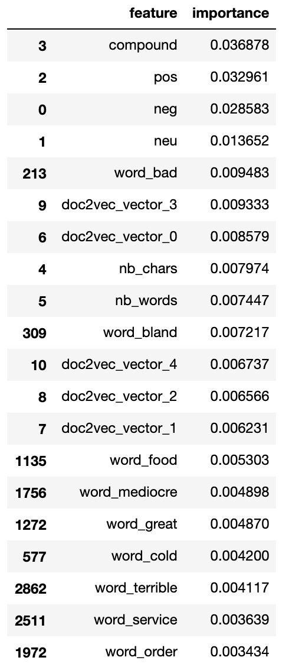
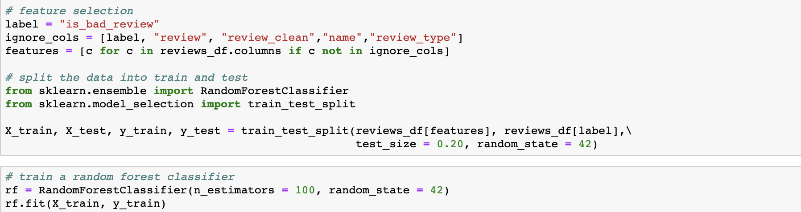
Build Random Forest Model
Use RandomForestClassifier from sklean to predict whether review is bad.
Features importance
The image showed features importance in decreasing orders.
Notes:
dawei

Slide 18
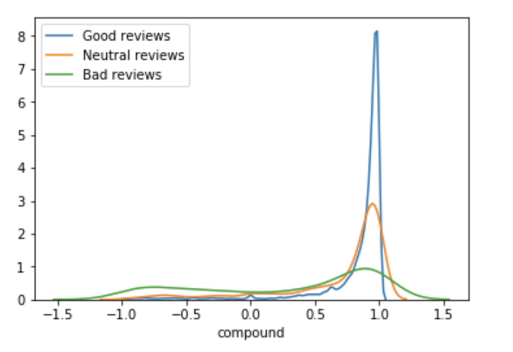
Distribution of Reviews between different Review Types
Good reviews: curve of compound is at peak around 1.0
Neutral reviews: curve is much flatter than good reviews
Bad reviews: curve is the flattest, and has a big proportion between -1.0 and -0.5
Notes:
dawei

Slide 19
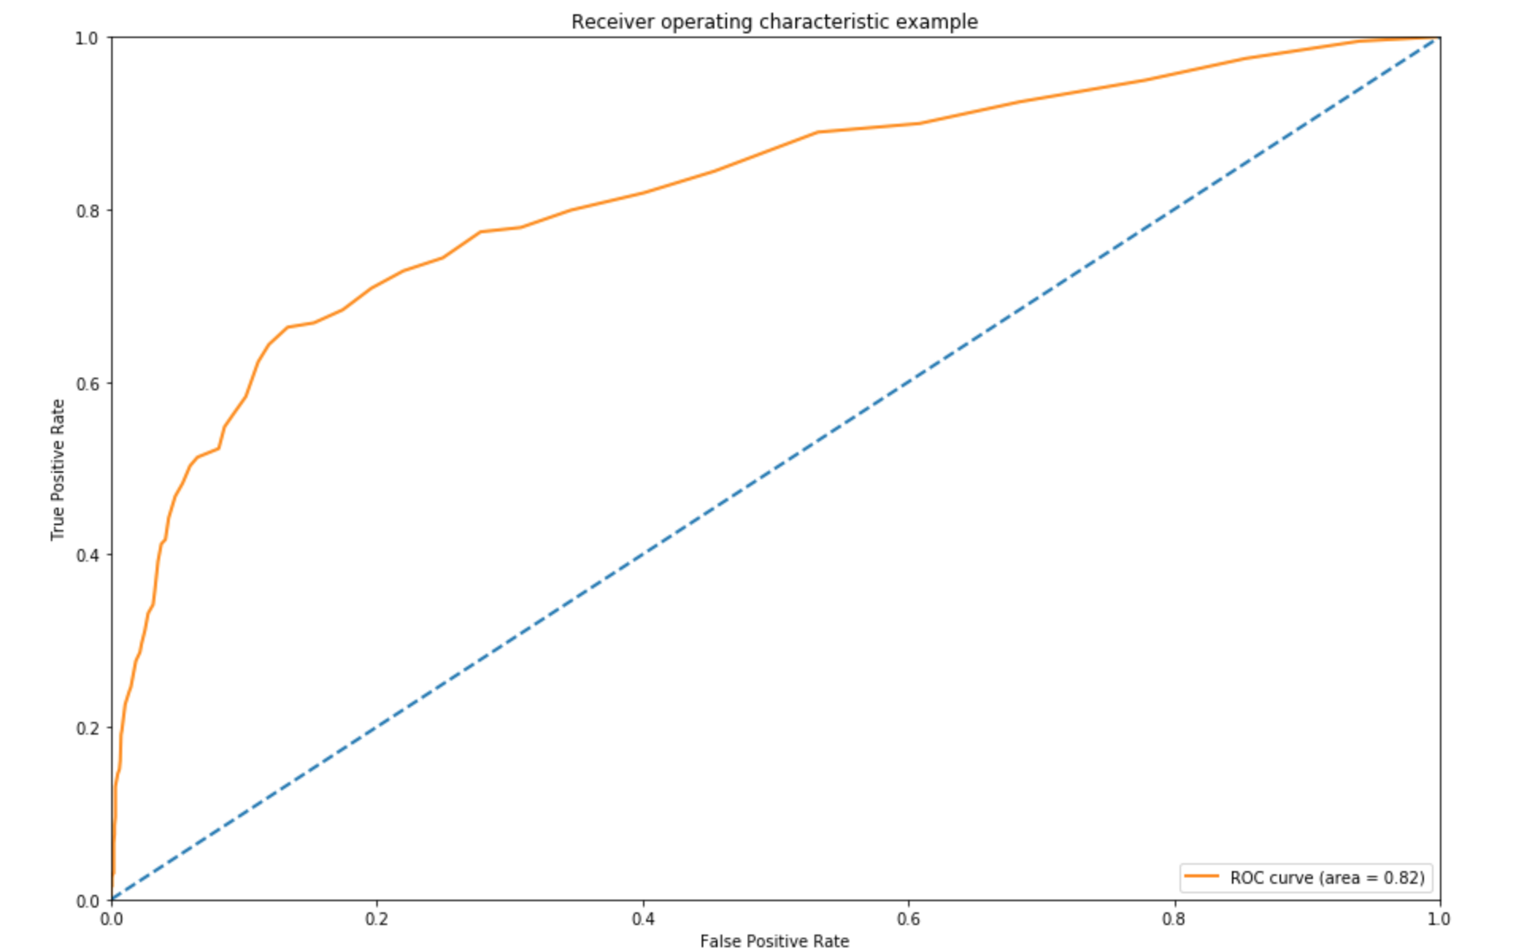
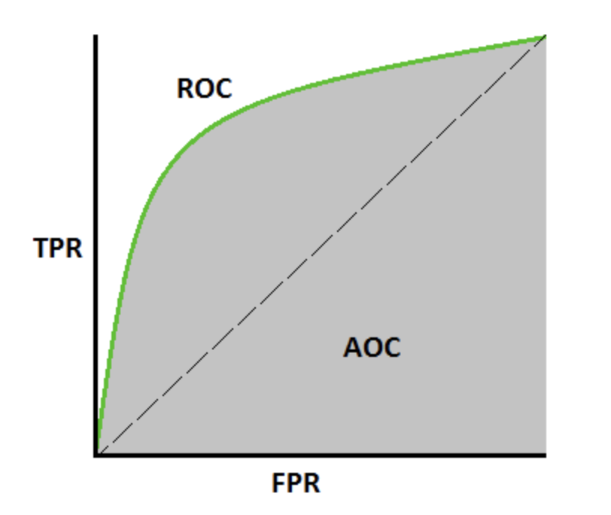
AUC-ROC Curve
ROC is a probability curve and AUC represents degree or measure of separability.
Higher the AUC, better the model is at predicting 0 as 0 and 1 as 1.
Notes:
dawei

Slide 20
Conclusion and Recommendations
6
Notes:
Hui

Slide 21
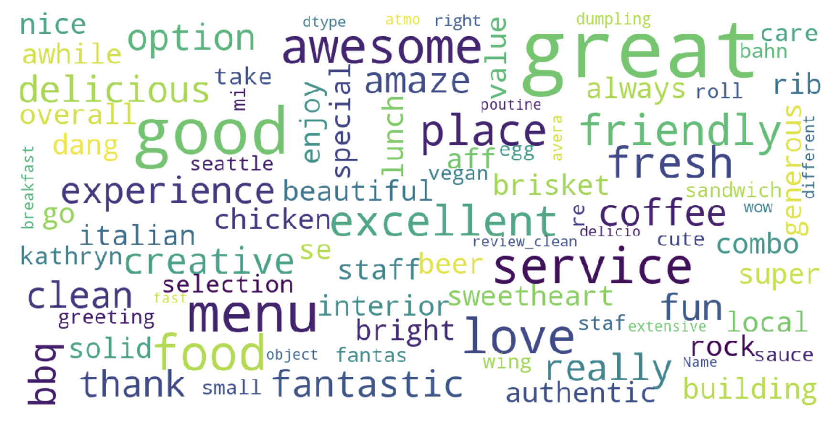
Conclusions
The most positive 20 reviews based on all reviews from 50 restaurants
Notes:
top 20 positive

Slide 22
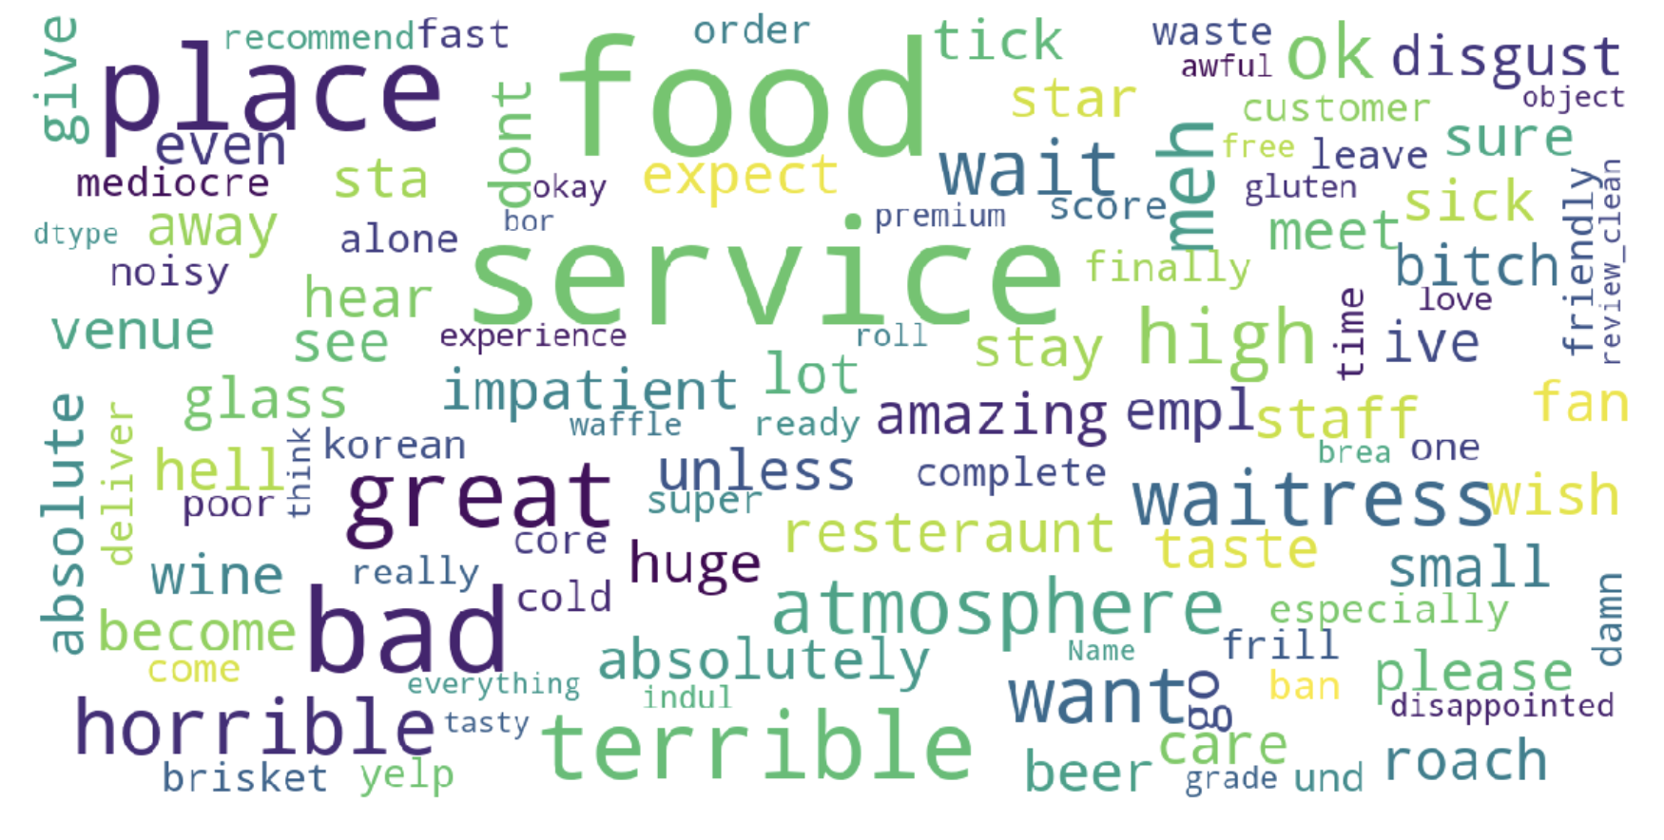
The most negative 20 reviews based on all reviews from 50 restaurants

Slide 23
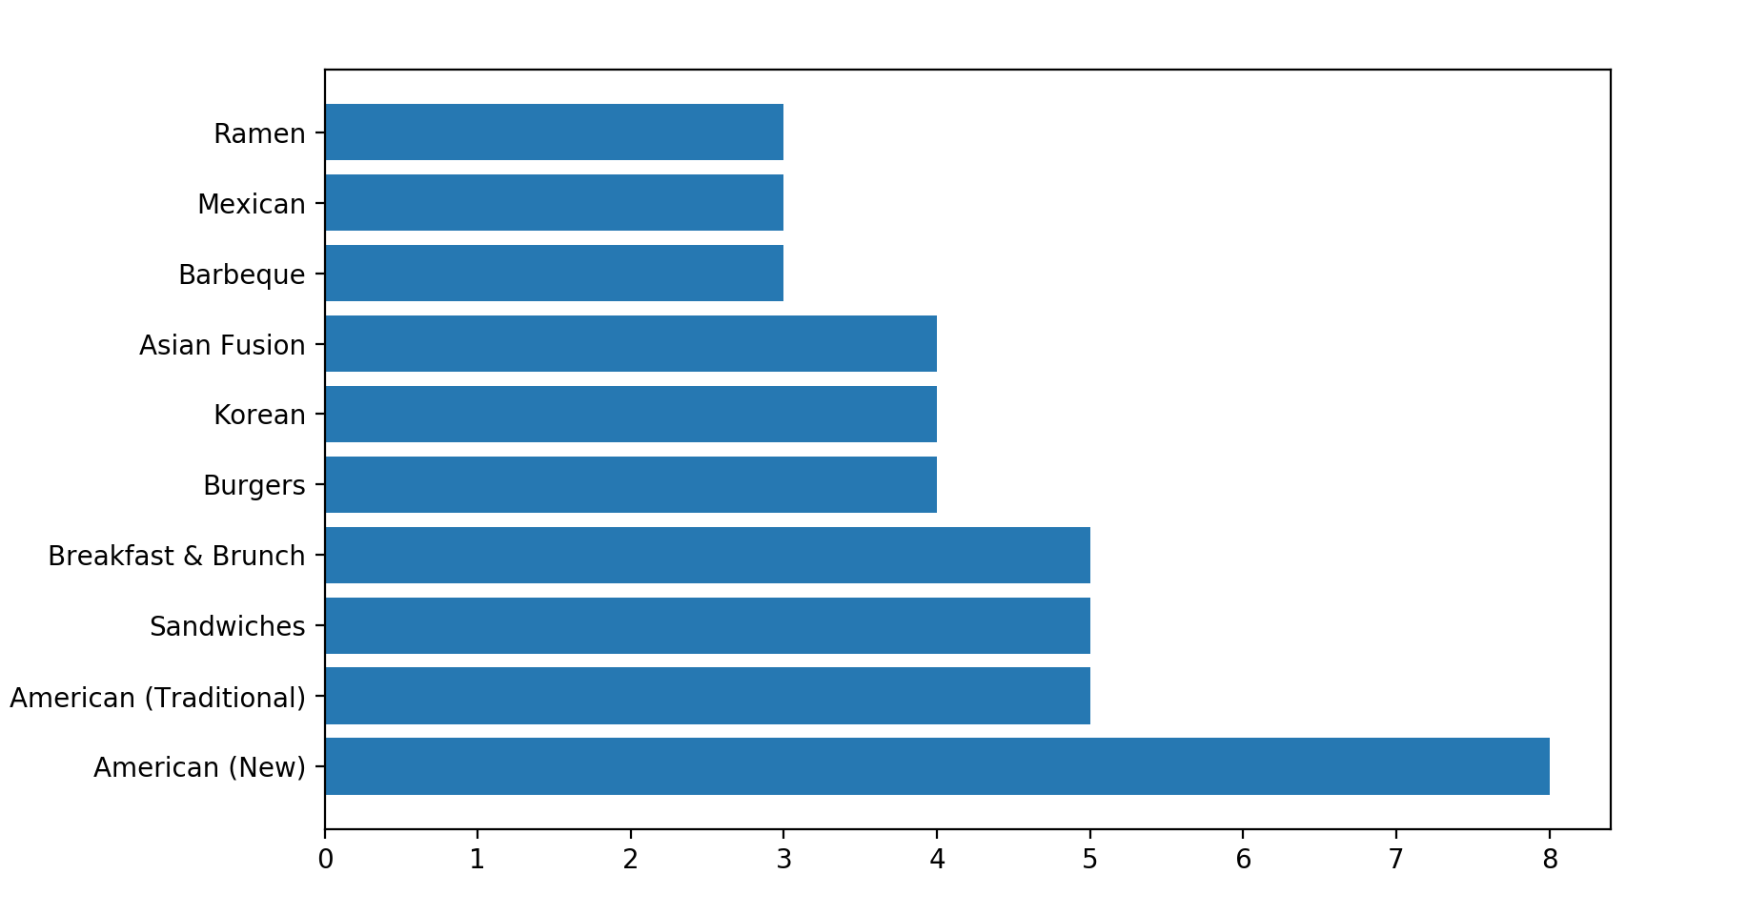
Recommendations
To promote the customer satisfaction, restaurants should pay more attention on their food and service.
To boost a restaurant’s business at Syracuse, people can reference “the top 10 most popular food types in Syracuse ” below.

Slide 24
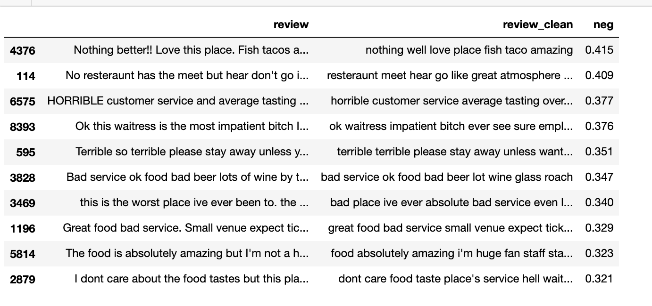
Recommendations
Merchants should check their negative seriously and carefully, because negative reviews contains not only bad parts, but also good parts. After knowing customers’ feedbacks, they can run their business better.

Slide 25
Thank You！
Any Question?
IST 664 | Group 8 Liuqi Qian | Huiyu Li | Wenqing Ling | Dawei Guo

